Slide 1
Investment Advisor
Python Project
Prepared By :
1). Prashant Pagare
2). Nikit Oommen
3). Munavar P.

Slide 2
Introduction
Project Overview
Data Gathering
BSE500 5th Sept 2022 Data
Income / Expenses Data of a Person
Data Analysis with Python and SQL
Analysis Results to help the Person for invest in the Good Sector
Preparation of BSE500 data KPI by using Tableau Dashboard

Slide 3

Calculation of Investment Amount of a Person

Slide 4

Analysis of Income / Expense
Connection of Spreadsheet with G-Spread library to Python
Calculation of net income / expense
Updating Values to Spreadsheet using Gspread python

Slide 5
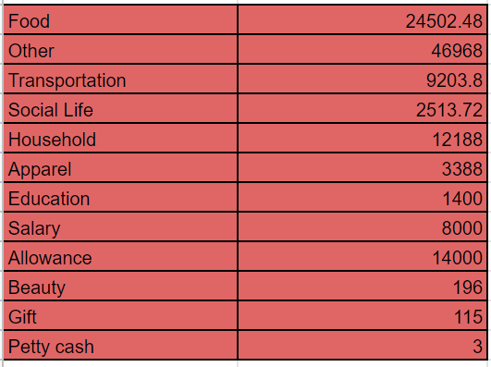
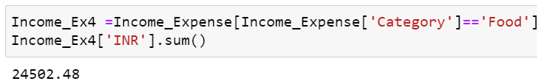
Analysis Miscellaneous Expenses
Calculate and update expenses of
different Categories to spreadsheet.

Slide 6

Analyse Available fund for Investment
Available for investment = Net Income - Net Expense

Slide 7

Analysis of BSE500 Data to choose best Stock for Investment

Slide 8
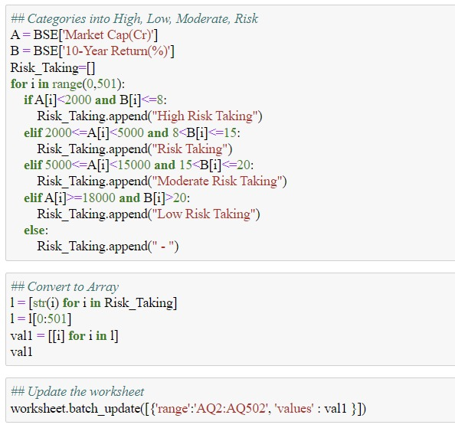
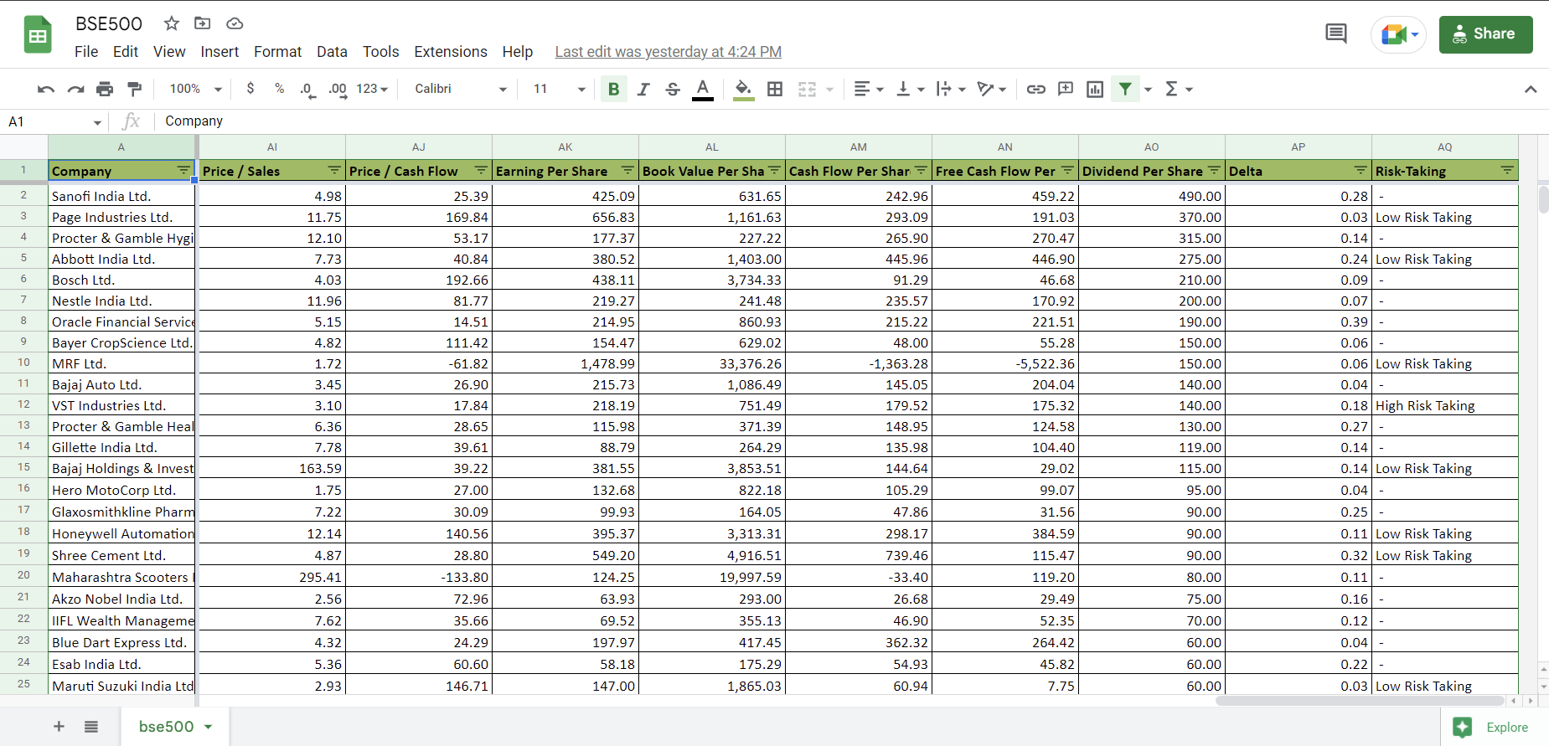
Categorizing Risk-Factors for Investment

Slide 9
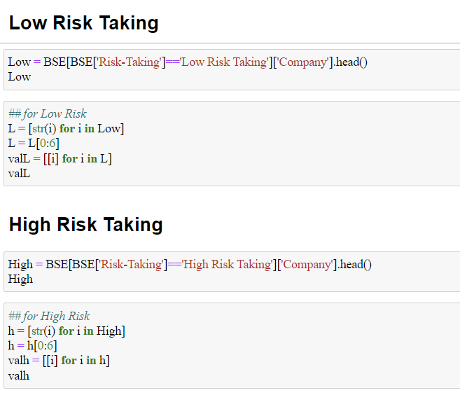
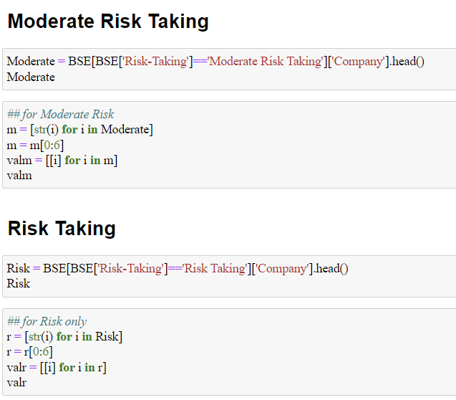
Analyse Top 5 Companies for different Risk-factors

Slide 10
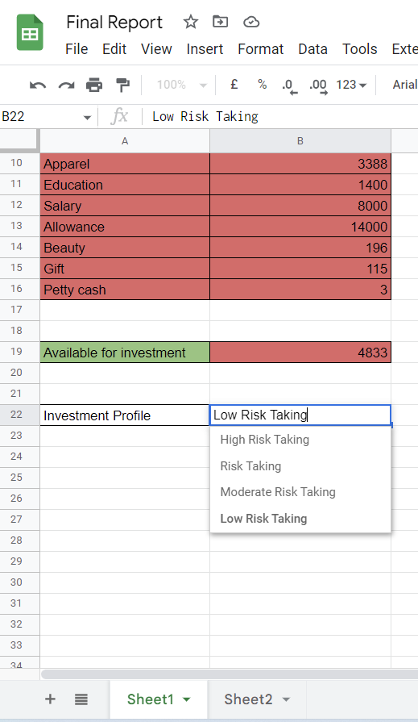
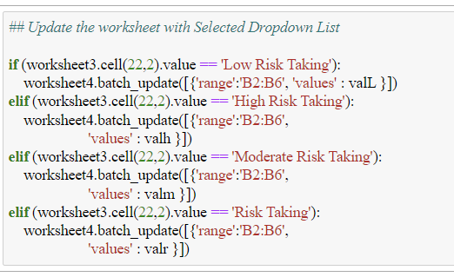
Update Spreadsheet Based on Selected Metrix
Calculate and update top 5 companies with investment amount where the money need to be invested as per the Investment Profile.

Slide 11
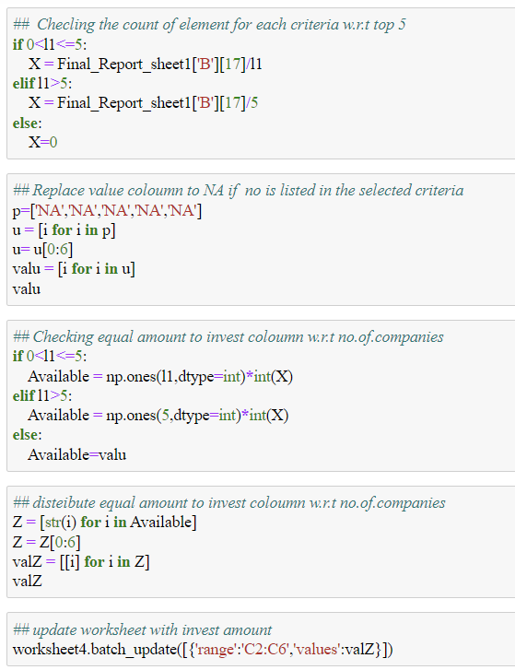
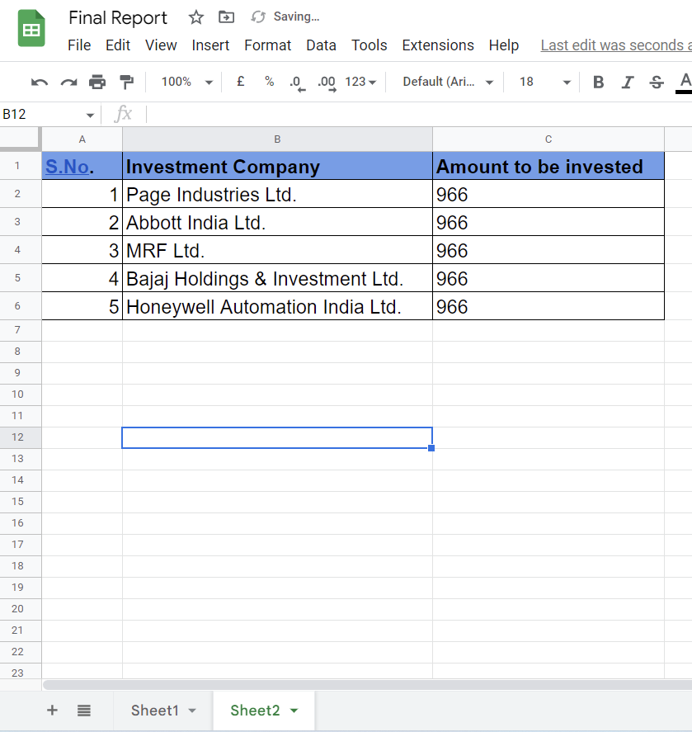
Calculation of Investment Amount

Slide 12
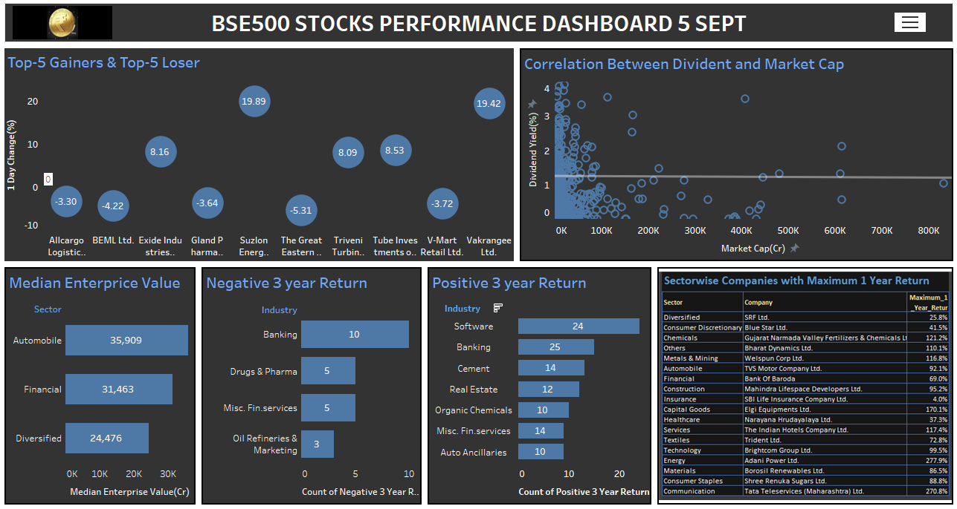

Slide 13
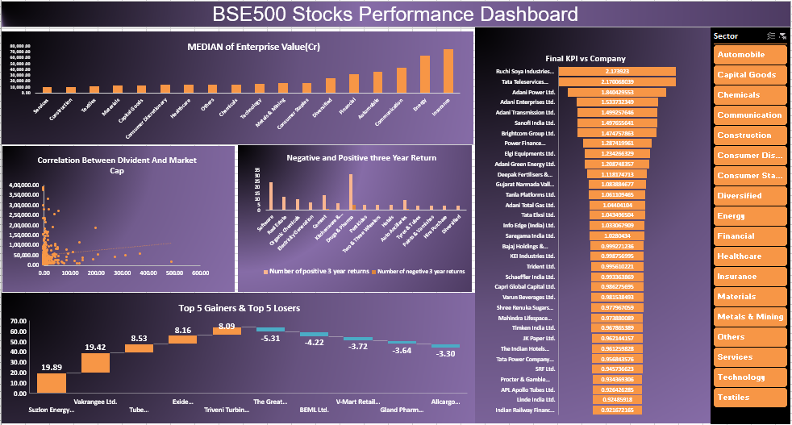

Slide 14
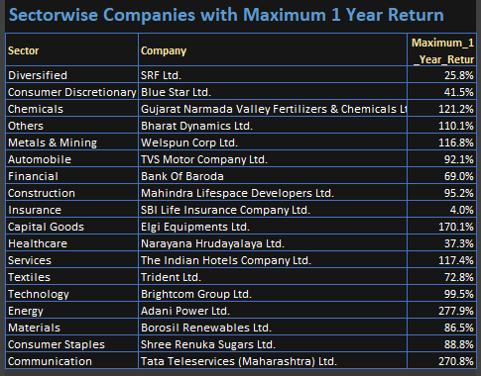
Conclusion and Insights

Slide 15
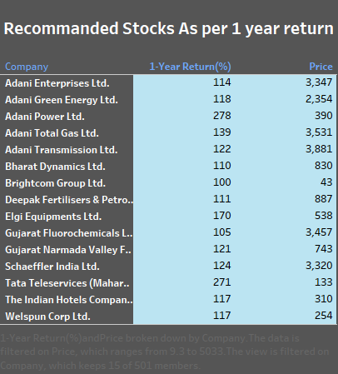
Stocks Recommended

Slide 16
Conclusion and Insights
1). Suzlon Energy ltd company having highest return on 5th Sept I.e. 19.89%.
2). The Great Eastern Shipping Company Ltd having lowest return on 5th Sept.
3). Energy Sector is giving more Dividend in BSE500.
4). Adani Group of Companies is having more Price to Earning.
5). MRF Ltd share price 84,254 is Highest share price.
6). If considered one year return Adani Power is giving 277.9% return.
7). MMTC Ltd. Company is under performance from last 10 year.
8). Reliance Industries Ltd. has the largest market capitalization, which aids investors in selecting the company that can match their risk and diversification requirements.

Slide 17
Challenges Faced in Project
Connection of Spreadsheet with Python.
Distribution of income amount equally among top 5
Companies.
Problem due to previous values in the sheet.
Recommendation of stock to the Person.

Slide 18
References
Python Ipynb file link
Tableau Dashboard Link
SQL Analysis Link
Income / Expenses Data file link
Fine Report Data File link
BSE500 Data File Link
Excel Analysis

